Slide 1
Trends in the Secondary Market
David Thorpe – Sedo GmbH
Second international conference for ccTLD registries and registrars of CIS, Eastern and Central Europe
7.-9.September 2009
www.sedo.com
Notes:
Give an introduction to the secondary domain name market. A lucrative area that is still relatively unknown within the area of online marketing.

Slide 2
Agenda
Introduction
Secondary Market Trends
Current Market Trends
Importance of establishing an online presence
Introduction to the secondary domain market
Sedo – who we are and the role we play
2009: market fights recession
Domain Pricing
Market figures 2005-2008
Online ad. spending
Direct Navigation and Brand Building
New sales opportunities
Domain names as marketing tools
Notes:
Introduction.
Introduce myself and my company. Where we stand in the domain heirarchy
Review the secondary market and explain trends over the last decade
Moving onto the situation today. I will explain how the market has been coping with the recent economic downturn. Which areas have suffered, how domain usage is changing, and future plans to encourage market growth
Secondary Domain Market is a relitavely new area

Slide 3
Who am I and what is Sedo?
David Thorpe
Sedo – Sales International. Based in Cologne, Germany
5 years experience in direct navigation, traffic monetisation and domain sales/marketing
Sedo - Buy, Park, Sell
“Ebay” for domain names
Traffic monetisation (PPC, CPA)
Cologne, Boston USA, London
180 Employees, 25+ languages spoken
Notes:
Cost per action

Slide 4
Sedo’s place in the domain hierarchy
ICANN
ccTLD Registies .si (ARNES), .ru (Coordination Center for TLD RU, .pl (NASK), .eu (EURid), .me (ME Reg.)
gTLD Registries
.com (VeriSign), .org (PIR), .mobi (.dotMobi)
Registrar
Blacknight (IRL)
Registrar
1&1 (DE)
Registrar
EURODNS (L)
Registrar
Hexonet (DE)
Sedo.com
(secondary market / aftermarket)
Notes:
To begin - would like to present our company in the context of an Icann family tree/hierarchy. As you can see from the graphic we deal exclusively with domain names that have already been registered. Essentially domain names that have been registered with the object of resale or Sedo is approached by buyers interested in acquiring unavailable domain names. We deal with domain registrars and have many global registrars as active partners. Furthermore

Slide 5
Secondary Domain Market
Domain Marketplace
1 million members
Auctions
Traffic Monetisation
PPC
Revenue streams from unused traffic
Ancillary Services
Domain Appraisals
Domain Escrow
Brokers
CPA
Average Price .com domain: € 1311
e.g. old campaign sites, redundant sites,
Domain Brokers
Partnership Programme
Online auditing
Rights Protection Programme (RPP)
5 million names parked
16 million domains listed for sale
Notes:
Sedo offers services that cover the spectrum of the secondary domain market. We have become the point on the web where clients meet to trade domain names. While there are other venues available and private domain sales take place (especially with ccTLDs) we are the only company to offer such a broad range of services: -

Slide 6
Sedo Chronology
2001-2004
Founded in 2001, Search Engine for Domain Offers
Previously no general platform where „used“ names could be bought and sold.
2004-2005
2004 Sedo becomes a global leader in secondary sales
2006-2009
2006/7 Sedo introduces an auction model
2007 Sedo acquires www.greatdomains.com for premium sales
2005 Sedo‘s premium monetisation service is launched
2009 Acquisition of „Revenue Direct“ parking platform
Notes:
Sedo began trading as an online platform back in 2001
The concept of domain trade was unheard of at this time. Our founders noticed a clear gap in the market - that there was no easy way of acquiring a domain nameGrowth in customer base and commitment to domain owners lead to Sedo becoming market leader

Slide 7
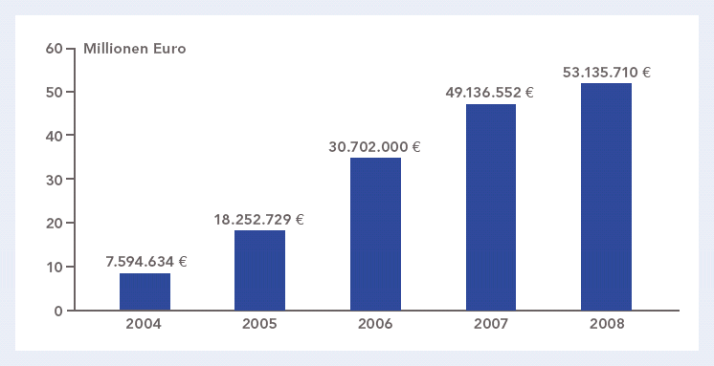
Development in the secondary market
2005 – 2008 unprecidented growth in transaction volumes:
Notes:
Growth in domain sales – reflected in the market in general.
Increase in domain registrations
€18m in transaction value in 2005
€31m in transaction value in 2006
€50m in transaction value in 2007
€70m anticipated for 2008
2009 expect to mirror that of 2008

Slide 8
Division of TLD sales
Notes:
Not surprisingly the .com extension is the most commonly transferred TLD.
Important to note is the continuing popularity of ccTLDs – notably the .de and .uk endings. We expect that a similar trend will increase in the future, with the addition of certain ccTLDs from Eastern Europe and certainly from China. The huge growth in registrations of the .CN domain extension will certiainly influence the market in the future

Slide 9
2009 : Domain name market fights global downturn
Recession bites: most significant trend – drop in average price for .com domains
Domain owners reevaluate their portfolios
Domain name aftermarket continues to experience growth:
Q2: 9403 domains sold, Q1: 9326 domains sold
Average price for .com alternatives increases - .net, ccTLDs.
e.g. Statoil.RU €23400
€€ High value sales show optimism
Notes:
Moving into this year. It is no surprise that the world economic crisis has taken it

Slide 10
Top Domain Sales to date 2009
Toys.com $5 100 000
Candy.com $3 000 000
Fly.com $1 760 000
Auction.com $1 700 000
Call.com $1 100 000
Webcam.com $1 020 000
Server.com $ 770 000
Brazil.com $ 500 000
Talk.com $ 500 000
Top.com $ 357 500
Source: DNJournal.Com

Slide 11
Sedo: Make a name for yourself
Aftermarket becomes more focussed towards end-user
Domains are recognised as important branding tools
Cost effective way of furthering product
Build an unknown brand into a new market
Cost effective way of entering into a market ahead of the competition
Rebrand entirely
ice.com diamond.com
Notes:
As the market matures, awareness of a secondary domain market increases. It becomes clear that users look to use a domain name to establish an online presence

Slide 12
Direct Navigation & Brand Building
Domain becomes a KEYWORD brand
Domains are chosen according to keyword terms
Instant recognition
First stop for those new to the category.
Premium name : credibility & independence

Slide 13
Future outlook : Buy, Park, Sell
Domain owners – need to sell large inventory
Sedo provide end-users opportunity to acquire the right name to establish an online presence
Portfolio owners need to ensure renewal fees are covered
Sedo‘s parking programme ensures renewal fees are covered
Registrars look to find sales solutions to maximise both their and clients‘ returns
New registrar cooperations open up secondary market

Slide 14
MLS - Distribution Network
Buyer
Large Portfolios
Registrar C
Registrar A
Registrar B
Registrar B
Buyer
Registrar A
Registrar C
Buyer
Retail Sellers
Buyer
Marketplace
Huge market – many registrars
Efficient channels – all fixed price selling
Liquid market – immediate transfer
Higher Sales
More Commission

Slide 15
SedoMLS - Registrar Advantages
Fulfil customer’s needs
Registrar clients have the opportunity to sell and buy domain names.
Huge domain inventory and best-in class search technology
Registrar profits from flexible sales commission
Increase domain renewal rate and primary registrations
Educate registrar clients: Once a registrant views a domain as an asset, they are more likely to renew the registration.
Gain Inventory
By offering members the chance to purchase domains directly you can automatically gain domains in your system and upsale additional products like hosting.
Notes:
Spelling is Labelling for UK; Labeling for US

Slide 16
Summary
Growth in the secondary market „peaked“ in 2007
Domain name market still experiencing increased activity – overall sales volume increasing.
Recession has caused many users to reevaluate their registration practises
Economic downturn has conversely meant that businesses turn to the Internet
High value sales boost market confidence
Fixed price domain names sell faster.
Domain owners look for a solution that covers all their needs at one place
B2B cooperations increase future sales

Slide 17
Thank you! Спасибо Большое!
Contact: David Thorpe david@sedo.com
Sedo GmbH
Im Mediapark 6
50760 Köln
Germany
+ 49 221 340 30 242

